Slide 1
PRESENTATION Capstone Project –
The Battle of Neighborhoods (Week 2)
By
Heidrich Vicci

Slide 2
1.Introduction & Business Problem:
A restaurant is a business which prepares and serves food and drink to customers in return for money, either paid before the meal, after the meal, or with an open account. The City of New York is famous for its excellent cuisine. So, it is evident that to survive in such competitive market it is very important to strategically plan. Various factors need to be studied in order to decide on the Location such as:
New York Population
New York City Demographics
Are there any Farmers Markets, Wholesale markets etc nearby so that the ingredients can be purchased fresh to maintain quality and cost?
Are there any venues like Gyms, Entertainment zones, Parks etc nearby where floating population is high etc
Who are the competitors in that location?
Cuisine served / Menu of the competitors
Segmentation of the Borough Even though well-funded XYZ Company Ltd. need to choose the correct location to start its first venture. If this is successful, they can replicate the same in other locations. This would interest anyone who wants to start a new restaurant in New York city.

Slide 3
2. Data:
One city will be analysed in this project: New York City. We will be using the below datasets for analysing New York city
Data 1: Neighbourhood has a total of 5 boroughs and 306 neighbourhoods. In order to segment the neighbourhoods and explore them, we will essentially need a dataset that contains the 5 boroughs and the neighbourhoods that exist in each borough as well as the latitude and longitude coordinates of each neighbourhood. Data source: https://cocl.us/new_york_dataset Description: This data set contains the required information. And we will use this data set to explore various neighbourhoods of New York city.
Date 2: Indian restaurants in each neighbourhood of New York city. Data source: Foursquare API Description: By using this api we will get all the venues in each neighbourhood. We can filter these venues to get only Indian restaurants. Data 3: GeoSpace data Data source: https://data.cityofnewyork.us/City-Government/Borough-Boundaries/tqmj-j8zm Description: By using this geo space data we will get the New York Borough boundaries that will help us visualize choropleth map.

Slide 4
For this project we need the following data :
New York City data that contains list Boroughs, Neighborhoods along with their latitude and longitude.
Data source : https://cocl.us/new_york_dataset
Description : This data set contains the required information. And we will use this data set to explore various neighborhoods of new york city.
Indian resturants in each neighborhood of new york city.
Data source : Fousquare API
Description : By using this api we will get all the venues in each neighborhood. We can filter these venues to get only indian resturants.
GeoSpace data
Data source : https://data.cityofnewyork.us/City-Government/Borough-Boundaries/tqmj-j8zm
Description : By using this geo space data we will get the New york Borough boundaries that will help us visualize choropleth map.

Slide 5
Analysis
We will import the required libraries for python.
pandas and numpy for handling data.
request module for using FourSquare API.
geopy to get co-ordinates of City of New York.
Now we define a function to get the geocodes i.e latitude and longitude of a given location using geopy.
We define a function to intract with FourSquare API and get top 100 venues within a radius of 1000 metres for a given latitude and longitude. Below function will return us the venue id , venue name and category.
we will define a function to get venue details like like count , rating , tip counts for a given venue id. This will be used for ranking.
we define a funtion to get the new york city data such as Boroughs, Neighborhoods along with their latitude and longitude.
Approach
Collect the new york city data from https://cocl.us/new_york_dataset
Using FourSquare API we will find all venues for each neighborhood.
Filter out all venues that are Indian Resturants.
Find rating , tips and like count for each Indian Resturants using FourSquare API.
Using rating for each resturant , we will sort that data.
Visualize the Ranking of neighborhoods using folium library(python)

Slide 6
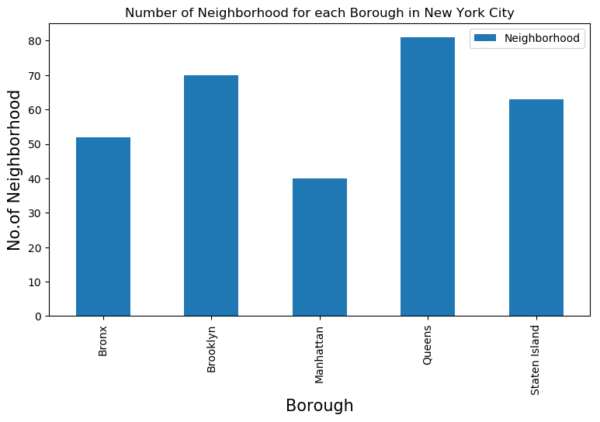
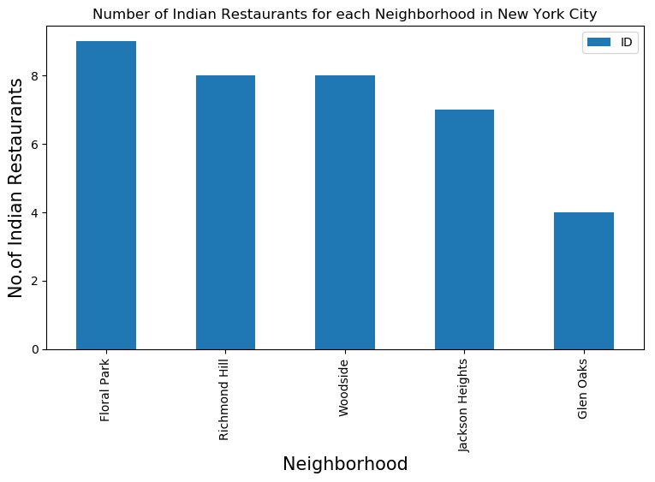
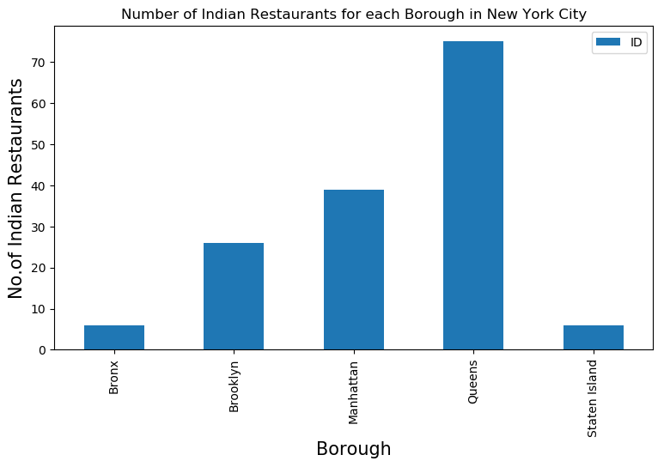
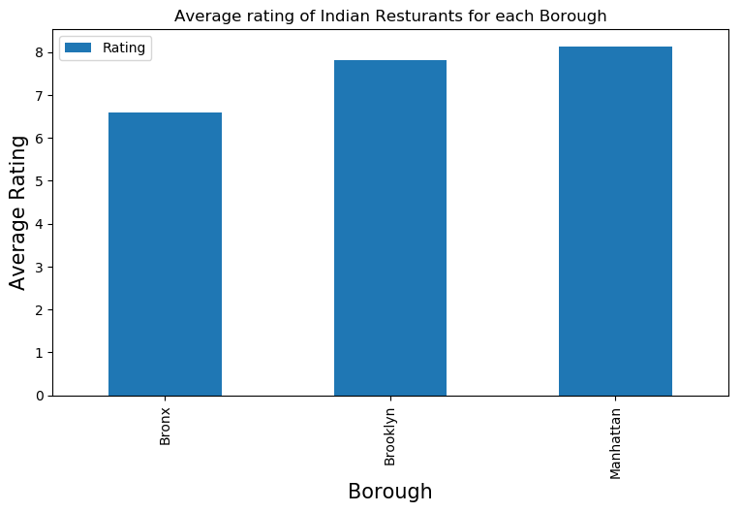
Results

Slide 7
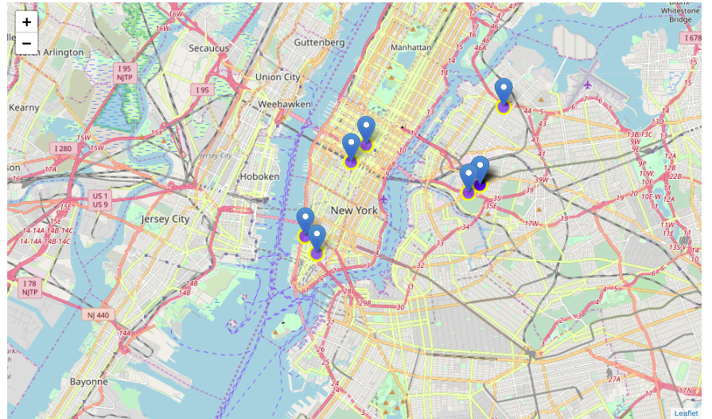
Best neighbourhoods in New York that has highest average rating for Indian Restaurants.

Slide 8
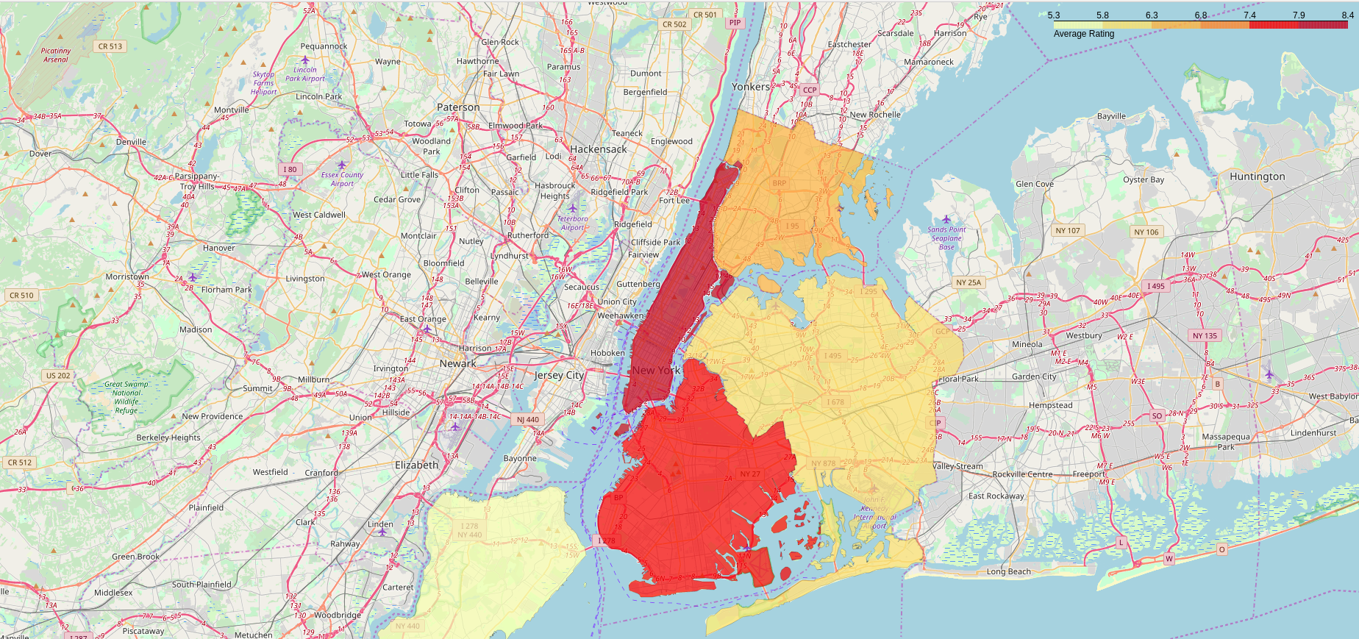
Borough Choropleth map based on average rating of Indian Restaurants.

Slide 9
Results 1. We see that Queens has the highest number of Neighbourhoods.
Conclusion
Astoria (Queens), Blissville(Queens), Civic Center(Manhattan) are some of the best neighborhoods for indian cuisine.
Manhattan have potential Indian Resturant Market/
Staten Island ranks last in average rating of Indian Resturants.
Manhattan is the best place to stay if you prefer Indian Cuisine.
Limitations
The ranking is purely on basis of rating of resturants
The accuracy of data depends purely depends on the data provided by FourSquare

